Slide 1
Naive Bayes
Natural Language Processing
Fall 2020
New York University

Slide 2
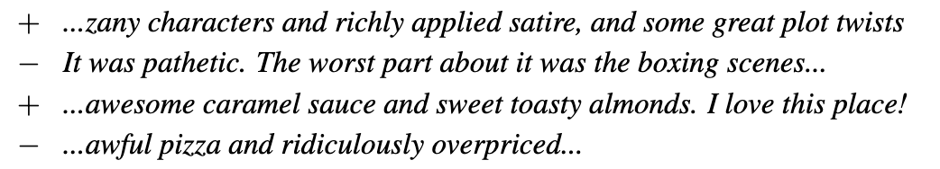
Text classification
Assigning a sentence (or passage) to one of a set of predefined categories
Example: sentiment analysis

Slide 3


Spam detection

Slide 4
Other text classification tasks
Authorship attribution
Topic classification: healthcare, sports, or political news?
Language identification
Toxicity detection (rude or disrespectful comments in a discussion forum)
Grammaticality detection

Slide 5
Text classification as supervised learning
Expert-created rules can sometimes work
Alternative: pay people to label a large set of examples (or find existing labels), then use machine learning
Set of (document, label) pairs:$\{(d_{1},y_{1}),(d_{2},y_{2}),…,(d_{n},y_{n})\}$
Fixed set of classes: $y_{i}∈\{C_{1},…,C_{k}\}$
Use $\{(d_{1},y_{1}),…,(d_{m},y_{m})\}$ for training, then evaluate on $\{(d_{m+1},y_{m+1}),…,(d_{n},y_{n})\}$

Slide 6
Bayesian classification
$c$: class
$d$: document
Posterior
Likelihood
Prior
$$P(c|d)=\frac{P(d|c)P(c)}{P(d)}$$
$$c_{\text{map}}(d)=arg\max_{c∈C}P(d|c)P(c)$$
How do we compute the likelihood $P(d|c)=P(w_{1},…,w_{l}|c)$?

Slide 7
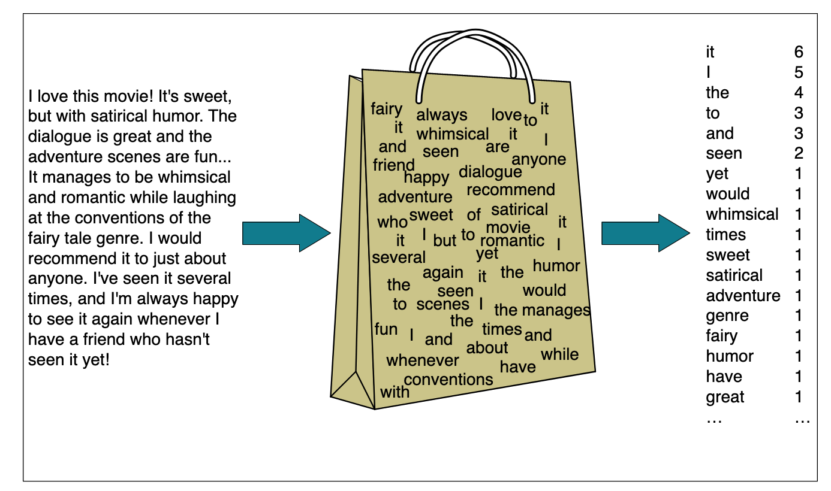
Representing documents
Each document needs to be represented as a vector of features
Very simple representation: bag of words
(SLP3)

Slide 8
Representing documents
Now instead of $P(w_{1},…,w_{l}|c)$, we need to compute $P(f_{1},…,f_{|V|}|c)$. Our sparsity problem hasn’t gone away!
We make a conditional independence assumption:$P(f_{1},…,f_{|V|}|c)=P(f_{1}|c)×…×P(f_{|V|}|c)$
The probability of generating seen twice is the square of the probability of generating it once
Neither the bag-of-words nor the conditional independence assumption is generally plausible
If the word “basketball” occurs in the text, the probability of “court” goes up…
But it could be a good start

Slide 9
Naive Bayes classifier
$l_{d}$: the length of the document
$$c_{\text{NB}}(d)=arg\max_{c∈C}P(c)\overset{l_{d}}{\underset{i=1}{∏}}P(w_{i}|c)$$

Slide 10
Training the classifier
$$\overset{̂}{P}(c)=\frac{N_{c}}{N_{doc}}$$
$$\overset{̂}{P}(w_{i}|c)=\frac{\text{count}(w_{i},c)}{∑_{w∈V}\text{count}(w,c)}$$
Do we want to use the maximum likelihood estimate? What if a word happened to occur 0 times in $c_{1}$ in training?
Alternative: $\overset{̂}{P}(w_{i}|c)=\frac{\text{count}(w_{i},c)+1}{∑_{w∈V}(\text{count}(w,c)+1)}$

Slide 11
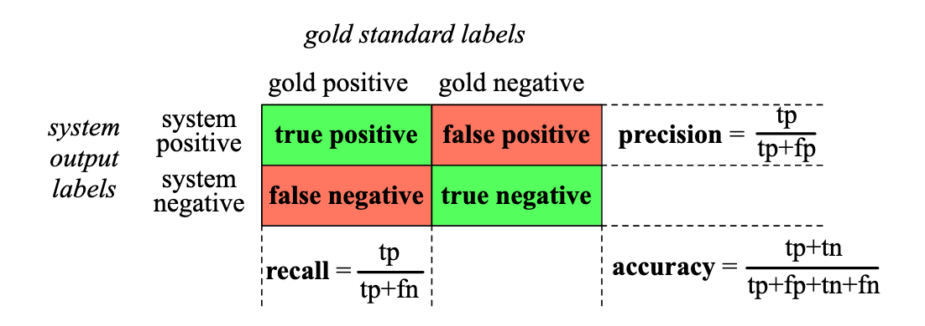
Evaluating the classifier
Use $\{(d_{1},y_{1}),…,(d_{m},y_{m})\}$ for training, then evaluate on $\{(d_{m+1},y_{m+1}),…,(d_{n},y_{n})\}$
Let’s assume $y_{i}∈\{\text{positive},\text{negative}\}$ for simplicity (for example, spam / not spam)

Slide 12
Evaluating the classifier
Accuracy isn’t helpful if there’s massive class imbalance
What’s the accuracy of the “nothing is pie” classifier? (99.9% of the words aren’t “pie”!)

Slide 13
Combined measure: F-score
$$F_{β}=\frac{(β^{2}+1)PR}{β^{2}P+R}$$
$$F_{1}=\frac{2PR}{P+R}$$
See textbook for evaluation when there are more than two classes

